Slide 1

銀行客戶定存預測
趙子寬

Slide 2



前言
動機發想
目標
使用工具
找出哪些客戶會進行定期存款的可能性較高
能夠更有效率的找到目標客群並提升成功率
運用銀行的客戶資料預測哪些客戶進行定期存款的意願較高
運用機器學習的分類模型進行預測

Slide 3
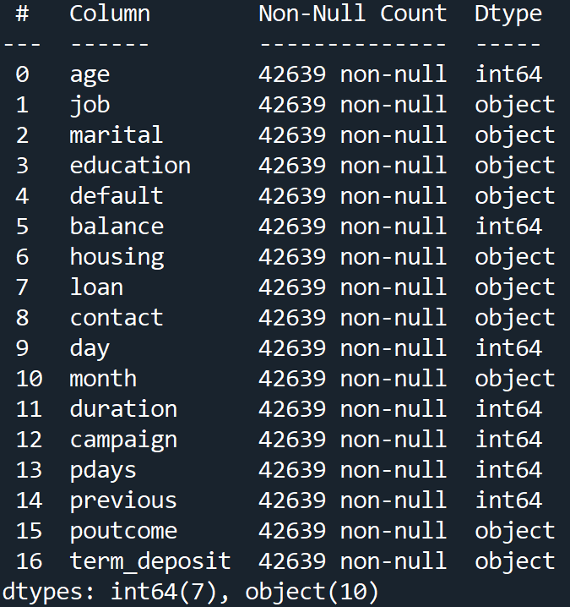
資料特徵

Slide 4
模型結果
DecisionTree
RandomForest
Accuracy:0.8642
Accuracy:0.8953
KNN
XGBoost
Accuracy:0.8838
Accuracy:0.8995

Slide 5
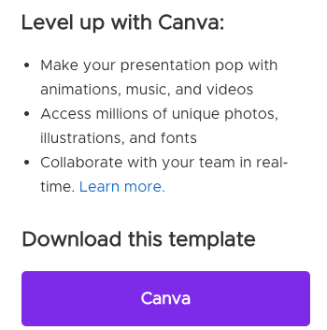
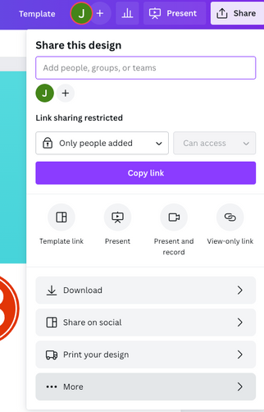
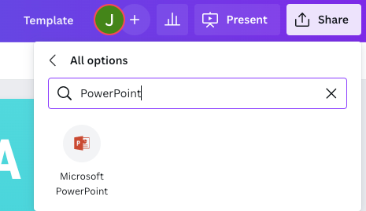
DOWNLOAD THIS PRESENTATION AS A
POWERPOINT TEMPLATE IN 3 STEPS
PROJECT TIMELINE
01
02
03
Click on the "Canva" button next to
this presentation. Start editing your presentation. You may need
to sign in to your Canva account.
Click on the "Share" button on the top right corner in Canva and click on "More" at the bottom of the menu.
Enter "PowerPoint" in the search bar
and click on the PowerPoint icon
to download.
PAGE NUMBER

Slide 6
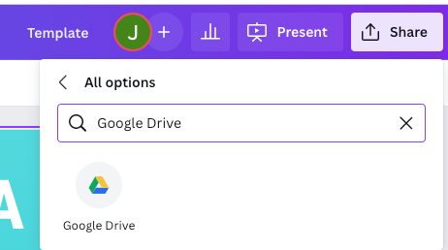
DOWNLOAD THIS PRESENTATION AS A
GOOGLE SLIDE TEMPLATE IN 3 STEPS
PROJECT TIMELINE
01
02
03
Click on the "Canva" button next to
this presentation. Start editing your presentation. You may need
to sign in to your Canva account.
Click on the "Share" button on the top right corner in Canva and click on "More" at the bottom of the menu.
Enter "Google Drive" in the search bar
and click on the Google Drive icon to add
this design as a Google slide in your G Drive.
It will ask you to link your Google account to
Canva the first time.
PAGE NUMBER

Slide 7

ADD AN
AGENDA PAGE
PROJECT TIMELINE
Write an agenda here.
Write an agenda here.
Write an agenda here.
Write an agenda here.
Write an agenda here.
Write an agenda here.
PAGE NUMBER

Slide 8
ADD A TIMELINE PAGE
PROJECT TIMELINE
ADD A MAIN POINT
ADD A MAIN POINT
ADD A MAIN POINT
ADD A MAIN POINT
01
02
03
04
Elaborate on what
you want to discuss.
Elaborate on what
you want to discuss.
Elaborate on what
you want to discuss.
Elaborate on what
you want to discuss.
PAGE NUMBER

Slide 9

ADD A TIMELINE PAGE
2015
2016
2017
2018
2019
ADD A MAIN POINT
ADD A MAIN POINT
ADD A MAIN POINT
ADD A MAIN POINT
ADD A MAIN POINT
Elaborate on what
you want to discuss.
Elaborate on what
you want to discuss.
Elaborate on what
you want to discuss.
Elaborate on what
you want to discuss.
Elaborate on what
you want to discuss.

Slide 10
ADD A TIMELINE PAGE
PROJECT TIMELINE
ADD A MAIN POINT
ADD A MAIN POINT
ADD A MAIN POINT
2015
2017
2019
Elaborate on what
you want to discuss.
Elaborate on what
you want to discuss.
Elaborate on what
you want to discuss.
2016
ADD A MAIN POINT
2018
ADD A MAIN POINT
Elaborate on what
you want to discuss.
Elaborate on what
you want to discuss.
PAGE NUMBER

Slide 11

2015
ADD A MAIN POINT
01
Elaborate on what
you want to discuss.
PROJECT TIMELINE
ADD A MAIN POINT
2016
Elaborate on what
you want to discuss.
02
ADD A TIMELINE PAGE
2017
ADD A MAIN POINT
03
Elaborate on what
you want to discuss.
ADD A MAIN POINT
2018
Elaborate on what
you want to discuss.
04
PAGE NUMBER
2019
ADD A MAIN POINT
05
Elaborate on what
you want to discuss.

Slide 12
ADD A TIMELINE PAGE
PROJECT TIMELINE
2016 | 2018 | 2020 | Present
Add a main point | Add a main point | Add a main point | Add a main point
Elaborate on what you want to discuss. | Elaborate on what you want to discuss. | Elaborate on what you want to discuss. | Elaborate on what you want to discuss.
PAGE NUMBER
ADD A TIMELINE PAGE

Slide 13



WRITE YOUR TOPIC OR IDEA
PROJECT TIMELINE
ADD A MAIN POINT
ADD A MAIN POINT
ADD A MAIN POINT
Briefly elaborate on
what you want to discuss.
Briefly elaborate on
what you want to discuss.
Briefly elaborate on
what you want to discuss.
PAGE NUMBER

Slide 14

Hello there!
I'm Rain, and I'll be sharing with you my beautiful ideas.
Follow me at @reallygreatsite to learn more.

Slide 15

PROJECT TIMELINE
WRITE YOUR TOPIC OR IDEA
Elaborate on what you want to discuss.
PAGE NUMBER

Slide 16

01
ADD A MAIN POINT
Elaborate on what
you want to discuss.
PROJECT TIMELINE
02
ADD A MAIN POINT
Elaborate on what
you want to discuss.
WRITE YOUR
TOPIC OR IDEA
03
ADD A MAIN POINT
PAGE NUMBER
Elaborate on what
you want to discuss.

Slide 17



WRITE YOUR TOPIC OR IDEA
PROJECT TIMELINE
01
02
03
ADD A MAIN POINT
ADD A MAIN POINT
ADD A MAIN POINT
PAGE NUMBER
Elaborate on what
you want to discuss.
Elaborate on what
you want to discuss.
Elaborate on what
you want to discuss.

Slide 18

03
WRITE A HEADING HERE
PROJECT TIMELINE
PAGE NUMBER

Slide 19
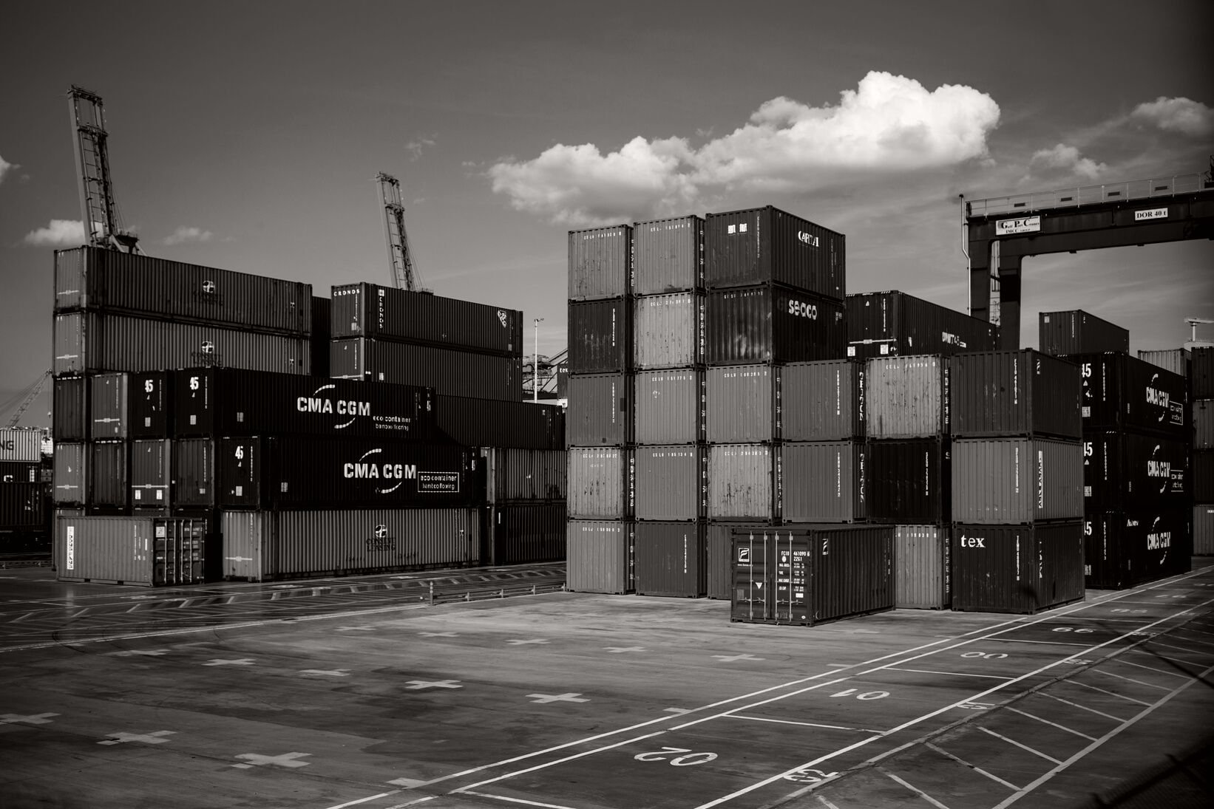



PROJECT TIMELINE
PAGE NUMBER
Write a caption for the photos.

Slide 20
INSPIRING QUOTE
PROJECT TIMELINE
WRITE AN ORIGINAL STATEMENT OR INSPIRING QUOTE
Include a credit, citation, or supporting message
PAGE NUMBER

Slide 21




ADD A TEAM MEMBERS PAGE
Elaborate on what you want to discuss.
NAME
NAME
NAME
NAME
Title or Position
Title or Position
Title or Position
Title or Position

Slide 22

PROJECT TIMELINE
ADD A SECTION HEADER
PAGE NUMBER

Slide 23


PROJECT TIMELINE
WRITE YOUR BIG TOPIC OR IDEA
Elaborate on what you want to discuss.
PAGE NUMBER

Slide 24

PROJECT TIMELINE
WRITE YOUR BIG TOPIC OR IDEA
PAGE NUMBER

Slide 25

123,456,789
PROJECT TIMELINE
PAGE NUMBER
Elaborate on the featured statistic.

Slide 26

2 OUT OF 5
Elaborate on the featured statistic.
12 MILLION
95%
Elaborate on the featured statistic.
Elaborate on the featured statistic.

Slide 27

Thank you!
PROJECT TIMELINE
PAGE NUMBER
Write a closing statement or call-to-action here.

Slide 28
CREDITS
PROJECT TIMELINE
This presentation template is free for
everyone to use thanks to the following:
SlidesCarnival for the presentation template
Pexels for the photos
PAGE NUMBER
Happy designing!

Slide 29
FONTS IN THIS PRESENTATION
PROJECT TIMELINE
This presentation template uses the following free fonts:
Titles
Headers
Body Copy
Merriweather
Merriweather
Alegreya Sans Medium
You can find these fonts online too. Happy designing!
PAGE NUMBER

Slide 30
S
W
PROJECT TIMELINE
STRENGTHS
WEAKNESSES
What are you doing well?
What sets you apart?
What are your good qualities?
Where do you need to improve?
Are resources adequate?
What do others do better than you?
O
T
OPPORTUNITIES
THREATS
What are your goals?
Are demands shifting?
How can it be improved?
What are the blockers you're facing?
What are factors outside of your control?
PAGE NUMBER

Slide 31
WRITE YOUR
TOPIC OR IDEA
25
PROJECT TIMELINE
20
15
10
5
PAGE NUMBER
Elaborate on what you want to discuss.
0
Item 1
Item 2
Item 3
Item 4
Item 5

Slide 32




ADD A CHART PAGE
NAME
Title or Position
NAME
NAME
Title or Position
Title or Position
NAME
NAME
NAME
NAME
Title or Position
Title or Position
Title or Position
Title or Position

Slide 33




































RESOURCE
Page
Use these design resources in your
Canva Presentation. Happy designing!
Don't forget to delete this
page before presenting.

Slide 34






PROJECT TIMELINE
Free templates for all your presentation needs
For PowerPoint,
Google Slides, and Canva
100% free for personal
or commercial use
Ready to use, professional,
and customizable
Blow your audience away
with attractive visuals
PAGE NUMBER

